Slide 1

Welcome to project 2 presentation
Covid 19 data analysis

Slide 2
of Group Member
1) Maiya Richardson
2) Sharyar Khan
3) Wakgari Gemeda

Slide 3
Tech stack
Scala
Visual studio code
Apache Spark
Spark SQL
Tableu
Excell
Git + GitHub

Slide 4
Feature of the project
Analysis the covid 19 data by different category.
Show the result of analysis on graphs using different software.

Slide 5
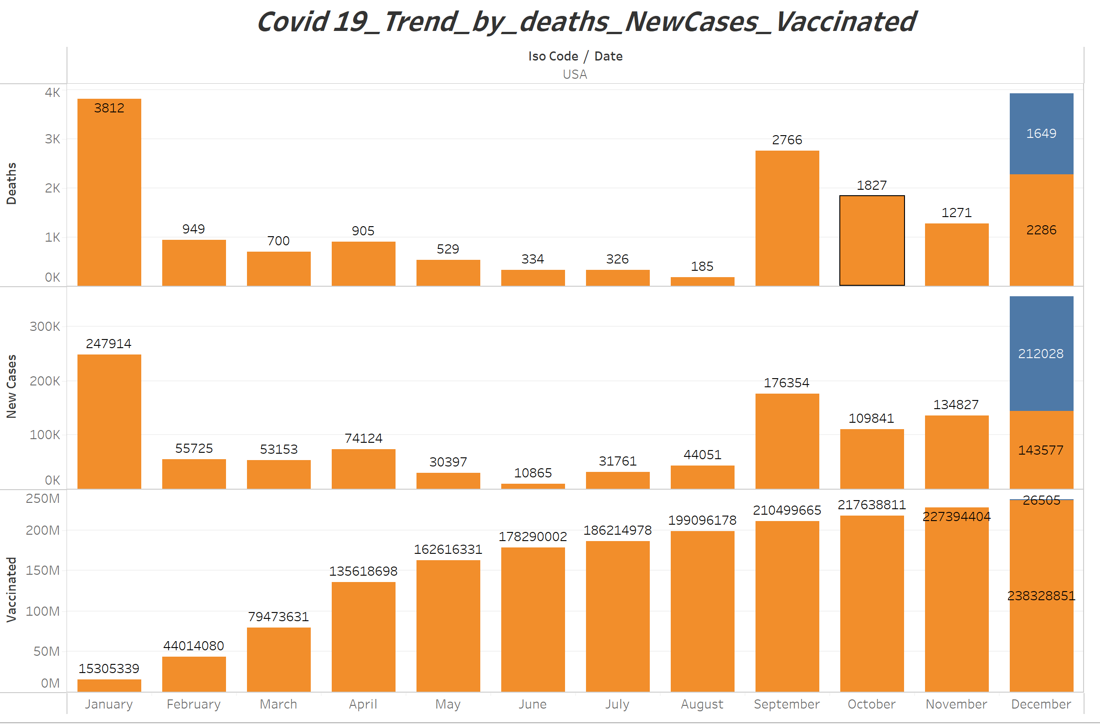

Slide 6
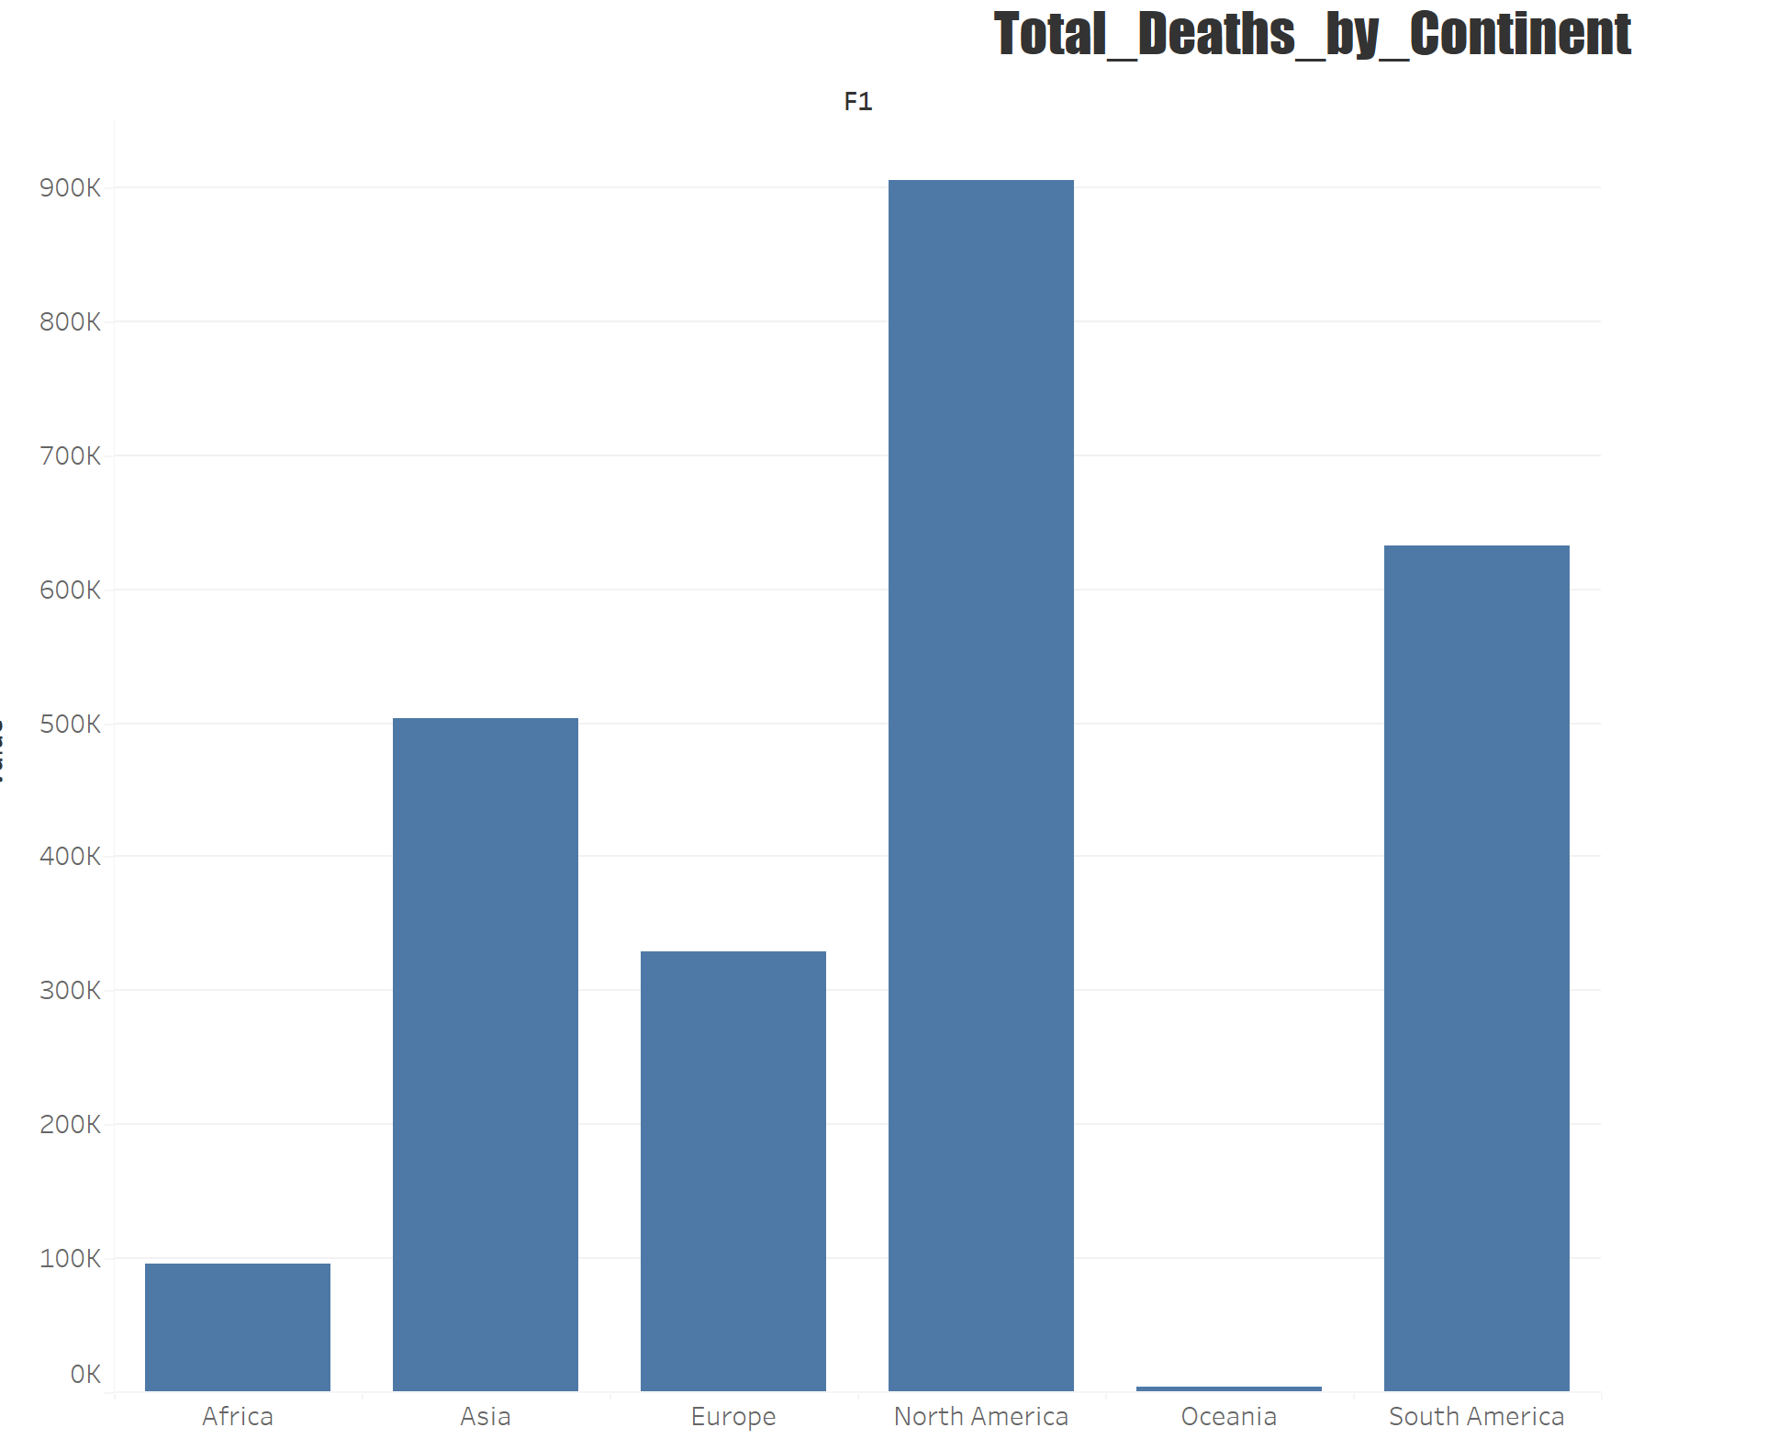

Slide 7

TIME TO DEMO

